Slide 1

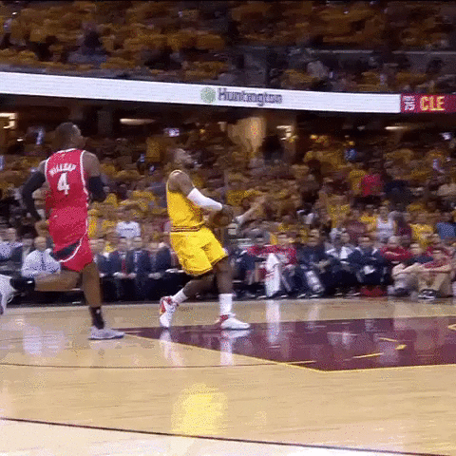
Team 9 - The Jordans
Fernanda Rangel
Jan Castillo
Diego DuVall
Marco Solorzano

Slide 2
Justification
Basketball is one of the most popular sports in the world, especially in North America.
This sport is rich in all kind of statistics, it permits to have a very good analysis
We think that the performance of a player is determined by the position of the player, thus, some positions always will have better performance than others.

Slide 3

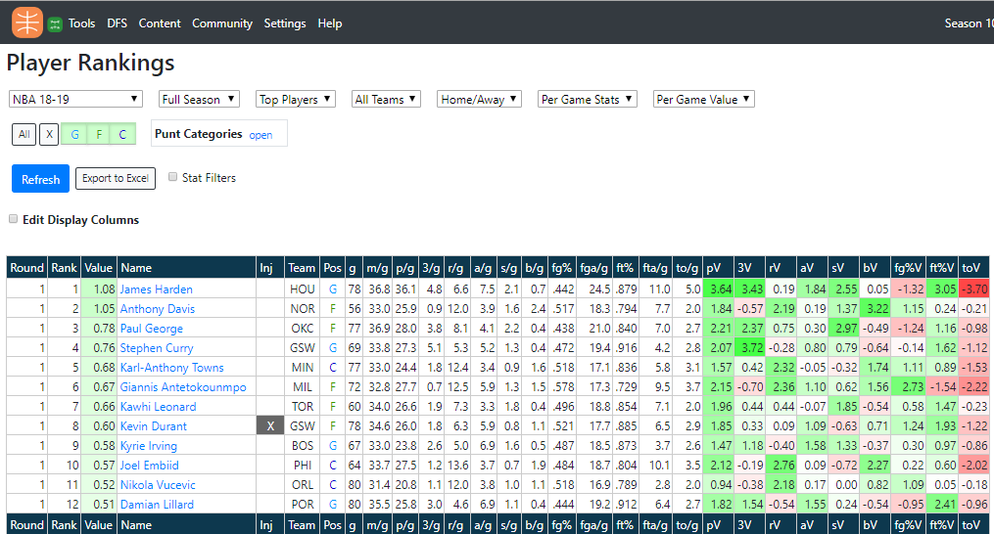
Our data sources
Basketball Monster
API - NBA

Slide 4
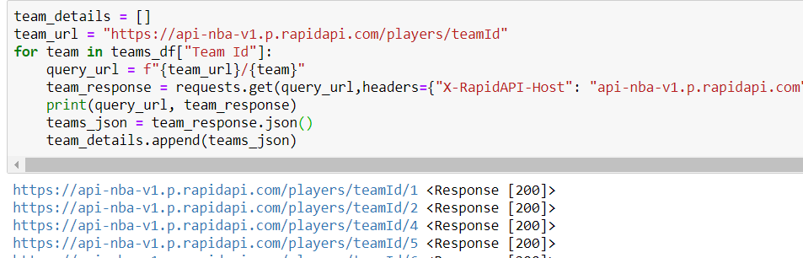
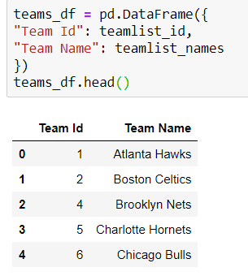
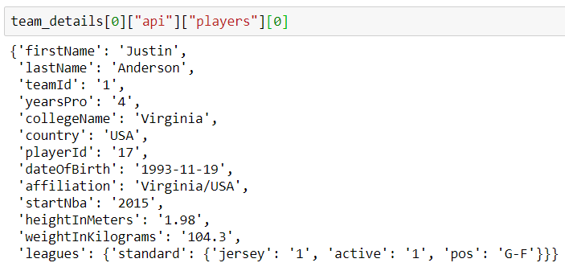
Exploration and Cleanup Process
Notes:
Jan

Slide 5
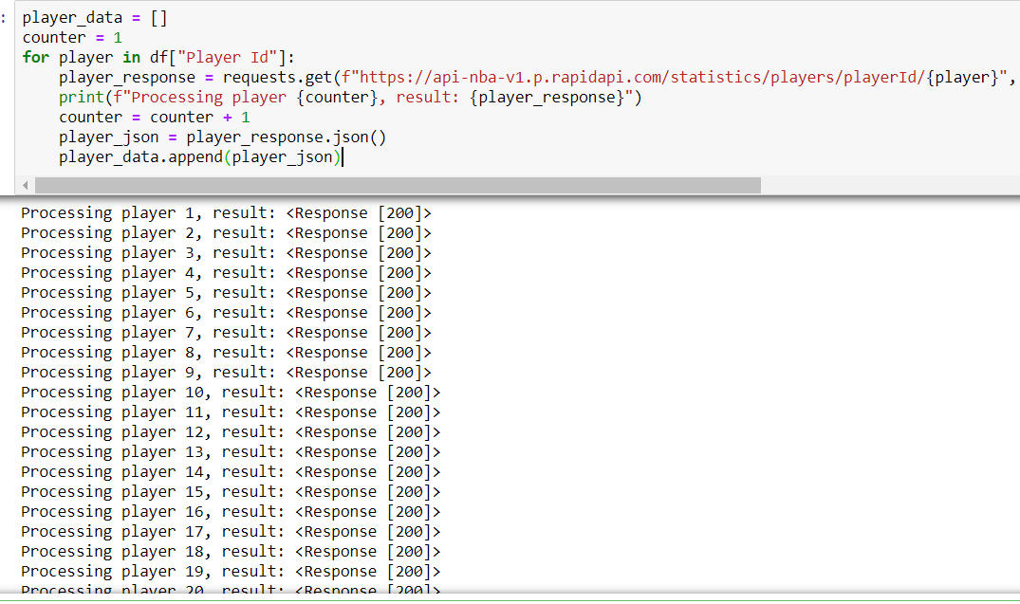
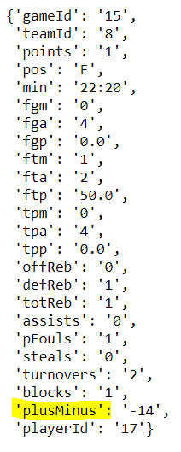
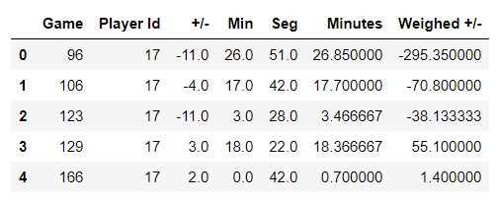
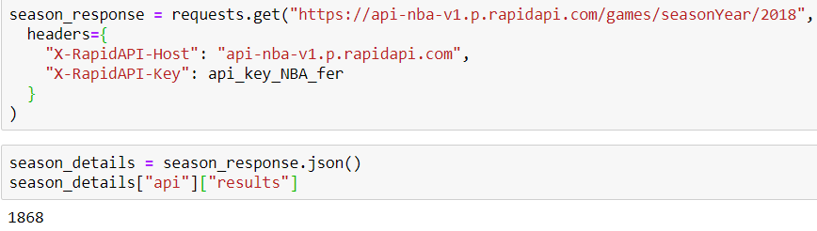
Notes:
Jan

Slide 6
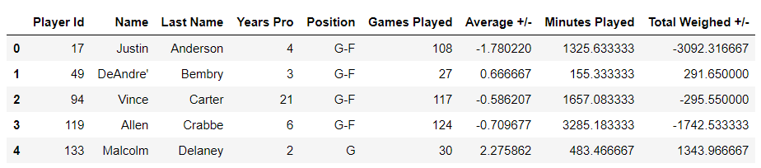
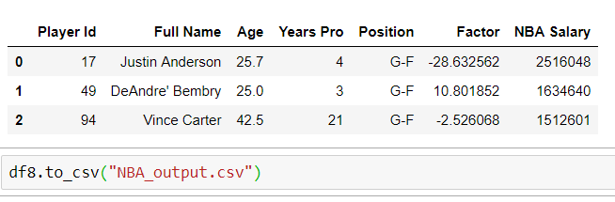
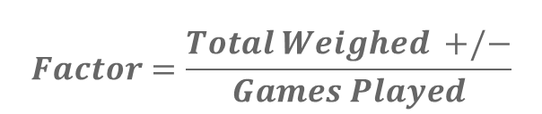
$$Factor=\frac{Total Weighed +/−}{Games Played}$$

Slide 7
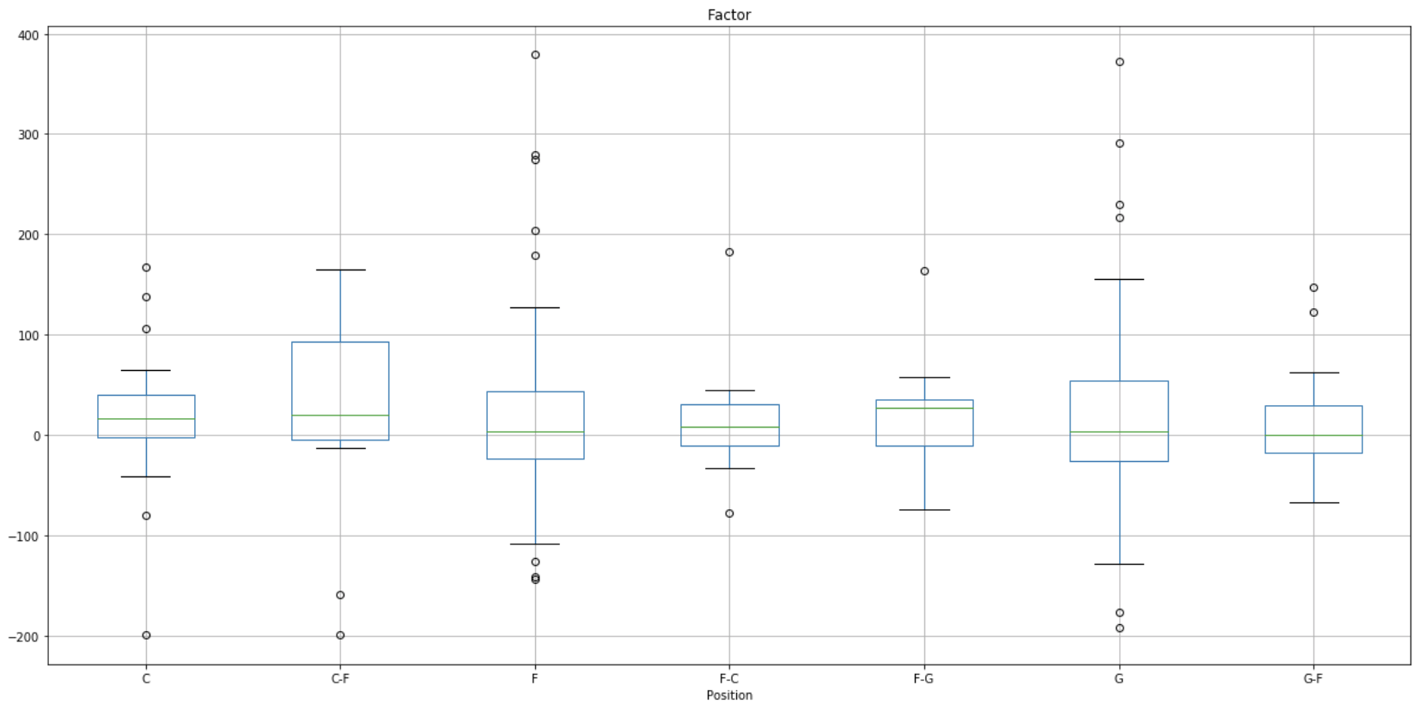
First Analysis
We did an anova analysis to check if the factor was statistically significant between positions.
We found that comparing just by positions was no statistically significant, so we decided to see if there was another factor that can tell us more.
Graph 1. Boxplot gruped by position

Slide 8
Our Hypothesis
1.- The effect of the age factor in the performance varies depending on the player’s position.
2.- Players with more experience will have a better factor
3.- Investment pays back because players with grater salary have a better performance

Slide 9
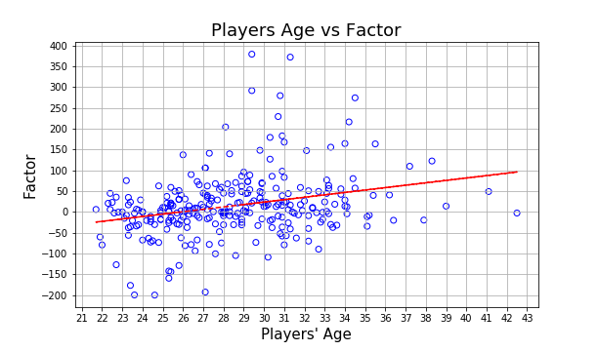
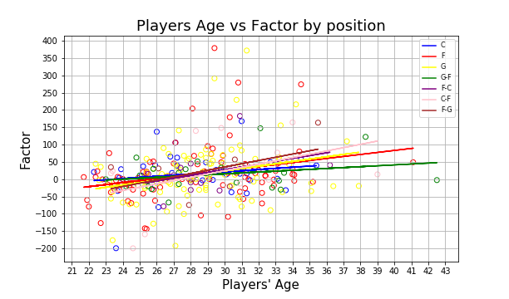
Age vs factor
Graph 2.1
Graph 2.2
Positive relation between factor and the age of the player
Notes:
Diego

Slide 10
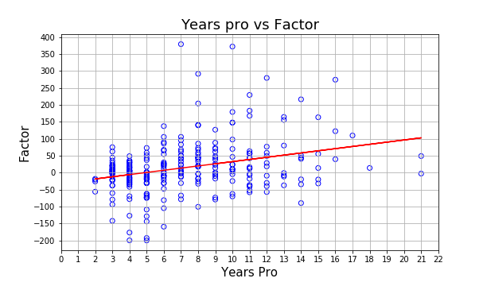
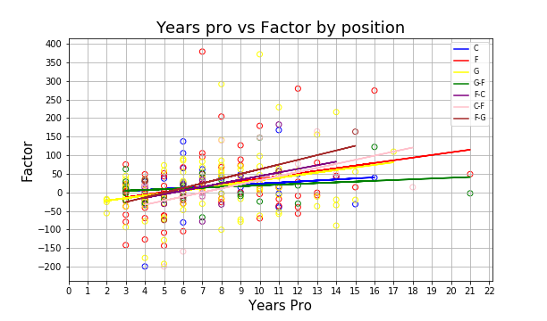
Years Pro vs factor
Graph 3.1
Graph 3.2
Positive relation between factor and how many years a player have been professional
Notes:
Diego

Slide 11
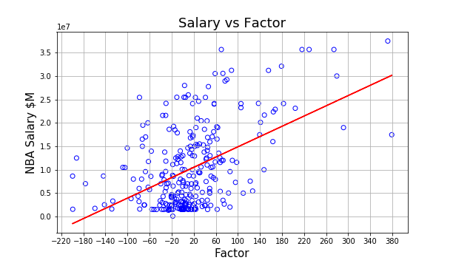
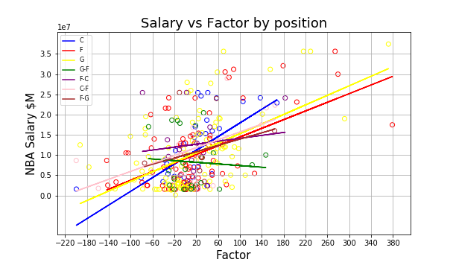
Salary vs factor
Graph 4.1
Graph 4.2
Also positive relation, but this time we can appreciate a stronger relation (grater slope) between our factor and how much do players earn per year.
Also we can apreciate a difference of Money Made vs Factor with players that play a single position vs players that play multiple positions.
Notes:
Diego

Slide 12
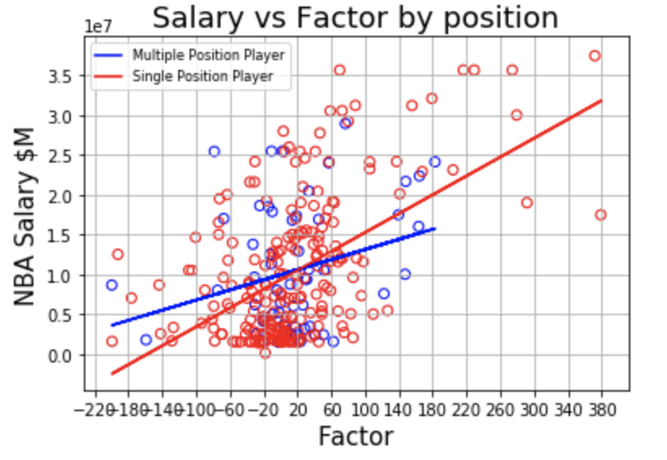
Salary vs factor (single vs mult positions)
Graph 5.
We decided to group the players that play single positions and multiple positions and to see if the factor impacted their salary more if they were a player that played multiple positions or single positions. In other words, are single position players paid higher for their productivity vs. players that play multiple positions
Notes:
Diego

Slide 13
Implications of your findings: what do your findings mean?
“F” position have a really good age range and is well paid
The effect of the age factor in the performance varies just a little between positions
A greater factor depends more on how many years a player have as pro instead of how old he is
It could be said that money could pay for talent in this sport

